Slide 1



VIRTUID
PRESENTED BY:
AADITYA GUPTA | GAUTHAM K K | LUCKY JAIN PRAVEENKUMAR | SANJANA RAYAPUDI | YASHWANTH VELLORE UMASHANKAR
Spring 2024

Slide 2





RECAP
CUSTOMER SEGMENTS
International Students
American youngsters
PROBLEM
GOAL
Risk of loss & theft
Damage to important documents
Concerns about data security
Identity theft
Securely convert physical IDs to digital
Streamline verification
Empower users for safer digital interactions.
Spring 2024

Slide 3







PROPOSED SOLUTION
CONVERSION OF PHYSICAL IDS TO DIGITAL FORMAT
STREAMLINED IDENTITY VERIFICATION PROCESSES
INTEGRATION WITH GOVERNMENT AND BUSINESS SYSTEMS
MULTI-FACTOR AUTHENTICATION
ENCRYPTION AND DATA SECURITY
USER-FRIENDLY INTERFACE AND ACCESSIBILITY
Spring 2024

Slide 4
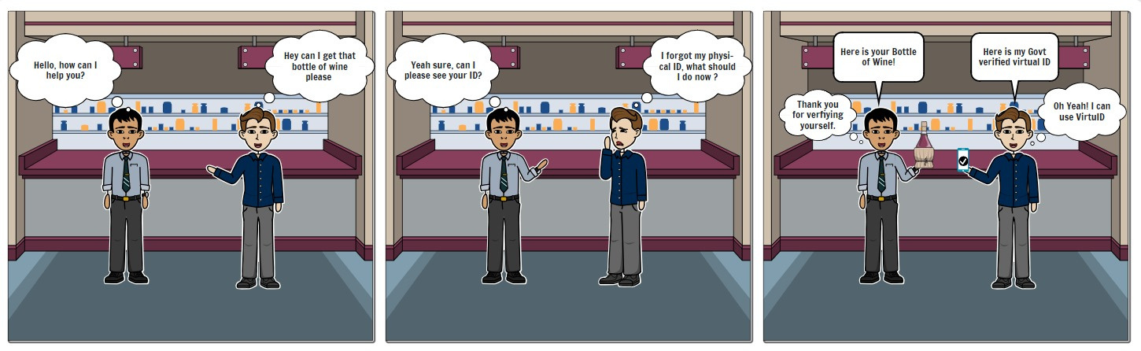
VISUAL STORYBOARD
Spring 2024

Slide 5
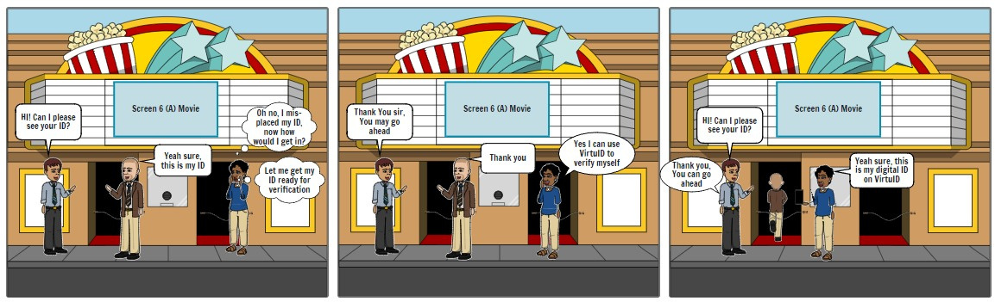
VISUAL STORYBOARD
Spring 2024

Slide 6

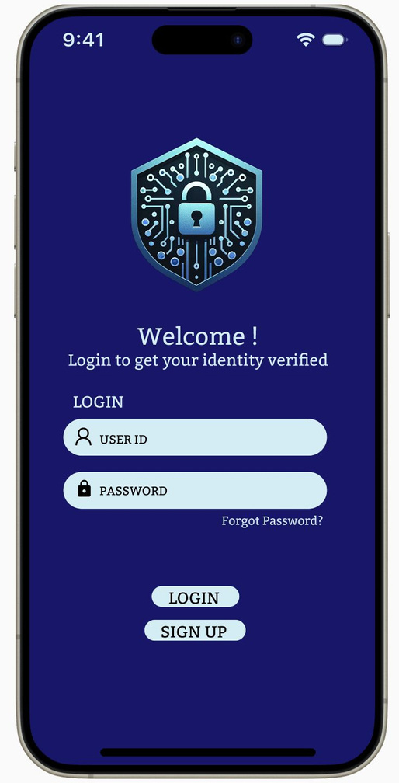
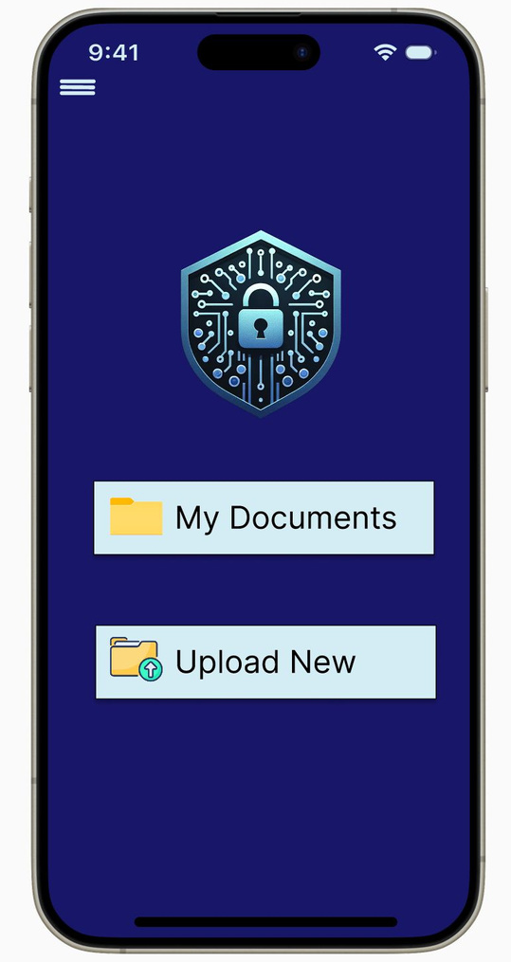
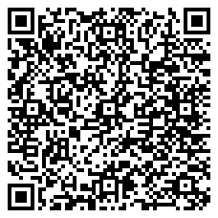

Prototype
LOGIN PAGE
HOME PAGE
Spring 2024

Slide 7
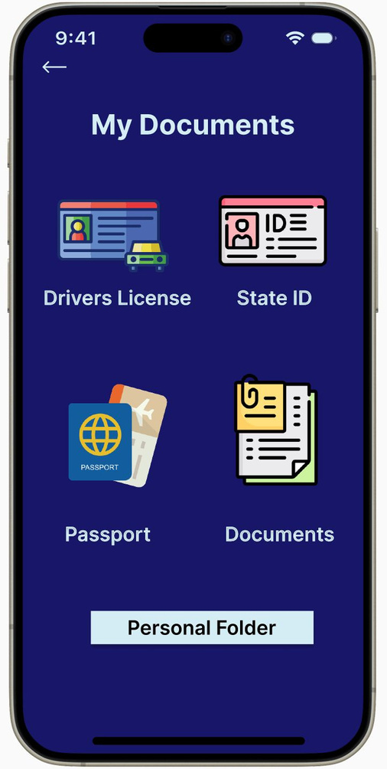
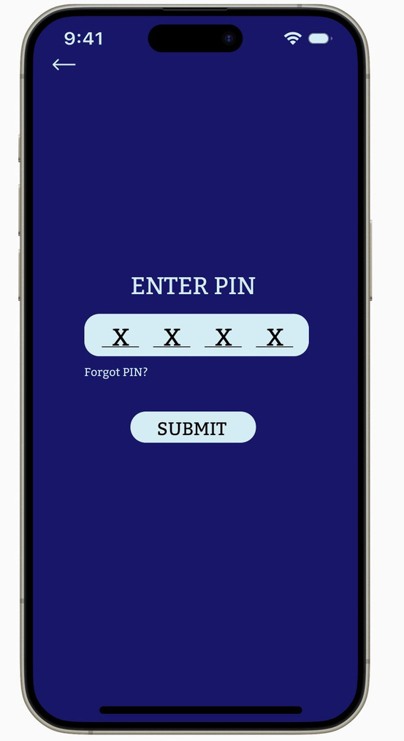
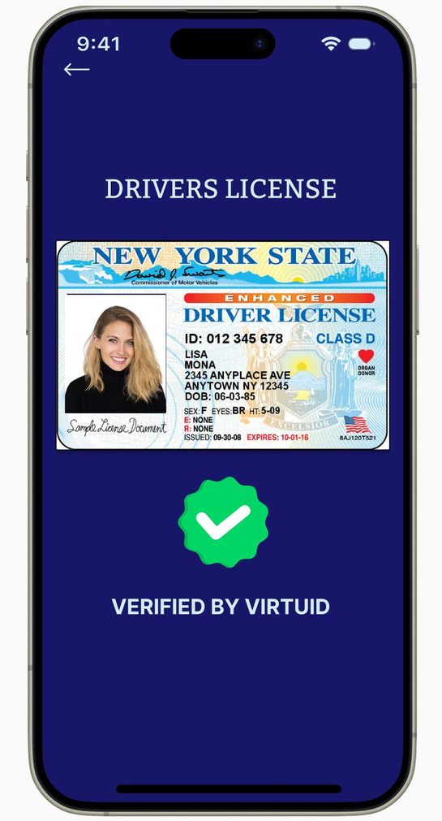
MY DOCUMENTS PAGE
ENTER THE PIN FOR ADDED SECURITY
SAMPLE VERIFIED DOCUMENT
Spring 2024

Slide 8

PRODUCT ROADMAP
Q1
Q2
Q3
Q4
LAUNCH
USER ACQUISITION & ENGAGEMENT
FEATURE ENHANCEMENTS
EXPANSION & OPTIMIZATION
INTRODUCING VRITUID
MARKETING STRATEGY DEVELOPMENT
FEEDBACK FROM NEW USERS
MARKETING CAMPAIGN LAUNCH
FEATURE UPDATES BASED ON FEEDBACK
DOCUMENT MANAGEMENT IMPROVEMENTS
PAYMENT INTEGRATION AND SECURITY ENHANCEMENTS
PERFORMANCE OPTIMIZATION
EXPANSION & OPTIMIZATION
PREMIUM SUBSCRIPTION FEATURE DEVELOPMENT
NEW MARKET USER ONBOARDING AND SUPPORT
ONGOING ENHANCEMENT & STRATEGY
DEVELOPMENT
Spring 2024

Slide 9










PRODUCT FEATURES
USER AUTHENTICATION
ID VERIFICATION
MY DOCUMENTS
PERSONAL FOLDER
ID UPLOAD
USER PROFILE
VERIFIER ROLE
NOTIFICATIONS
SETTINGS
LOG OUT
Spring 2024

Slide 10





ID CONVERSION
DIGITAL ID STORAGE
VERIFICATION FUNCTIONALITY
FEATURES OF MVP FOR LAUNCH
BASIC AUTHENTICATION
USER PROFILE MANAGEMENT
MINIMALISTIC USER INTERFACE
CROSS-PLATFORM ACCESSIBILITY
COMPLIANCE WITH REGULATIONS
Spring 2024

Slide 11






KEY METRICS
NUMBER OF SUCCESSFUL ID AUTHORIZATIONS PER MONTH/QUARTER
USER ENGAGEMENT RATE
USER RETENTION RATE
SECURITY BREACHES/INCIDENTS
PLATFORM UPTIME AND RELIABILITY
Spring 2024

Slide 12






OPERATIONAL NEEDS
USER SUPPORT TEAM WITH GOVERNMENT LIAISON
THIRD-PARTY VENDORS FOR STORAGE & SECURITY ENHANCEMENT
GOVERNMENT PARTNERSHIP PROPOSAL
TECHNICAL OPERATIONS TEAM FOR GOVERNMENT COMPLIANCE
DATABASE MANAGEMENT & COMPLIANCE SOLUTIONS
Spring 2024

Slide 13

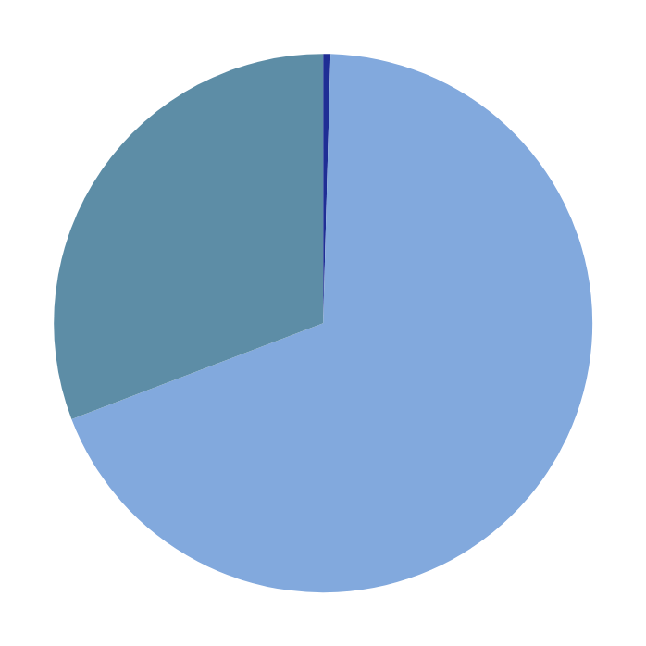
PROJECTED COSTS
TOTAL DEVELOPMENT TEAM COSTS = $240,000 + $14,400 = $254,400 ANNUALLY
2 Engineers x $120,000 = $240,000/ year
Intern costs = $30 x 20 x 24 = $14,400
0.4%
30.8%
OPERATIONAL COSTS
$9,500 x 12 = $114,000
68.8%
TOTAL INFRASTRUCTURE COSTS INFRASTRUCTURE: $135 X 12 = $1,620
TOTAL YEAR 1 COSTS: $370,020
Spring 2024

Slide 14
ADDRESSING RISKS
RISK
MITIGATION STRATEGY
GOVERNMENT COOPERATION SETBACKS
Establish clear communication channels with government entities and involve them in the development process from the outset. Address any concerns or requirements they have proactively to ensure smooth collaboration.
DATA SECURITY APPREHENSION
Implement robust security measures such as encryption, multi-factor authentication, and regular security audits. Provide transparent information about data protection practices to build user trust.
REGULATORY COMPLIANCE SHIFTS
Stay informed about regulatory changes and adapt VirtuID to meet evolving compliance requirements.
ENCRYPTION VULNERABILITIES
Regularly update encryption protocols to address emerging threats. Conduct thorough security assessments and penetration testing to identify and mitigate vulnerabilities.
RELUCTANCE TO SWITCH
Provide comprehensive user education and support to address misconceptions and build confidence in VirtuID's capabilities.
Spring 2024
Spring 2024

Slide 15


THANK YOU
Spring 2024

